Slide 1

React Components – Deep Dive
Component Lifecycle, CSS Modules, Context API
SoftUni Team
Technical Trainers
Software University
https://softuni.bg

Slide 2

Table of Contents
Component Lifecycle
Higher-Order-Components
CSS Modules
Fetching Data
Context API

Slide 3
Have a Question?
sli.do #js-web

Slide 4

Component Lifecycle

Slide 5
Component Lifecycle
A component has "lifecycle methods" that can be overridden to run code at times in the process
A component has 3 lifecycle phases
Mounting
Updating
Unmounting

Slide 6
Lifecycle Methods
Mounting - where the component and all its children are mounted (created and inserted to the DOM)
Updating - component is re-rendered because changes are made to its props or state
Unmounting - occurs when a component instance is unmounted (removed from the DOM)

Slide 7
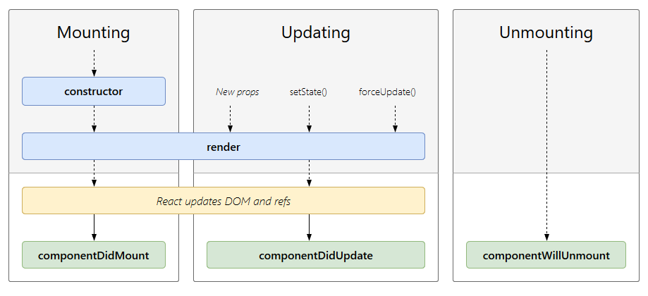
Component Lifecycle

Slide 8
Component Mounting
After preparing with basic needs, state and props a Component is ready to mount in the browser DOM
constructor
static getDerivedStateFromProps
render
componentDidMount

Slide 9
Component Updating
This phase starts with the beginning of the react component and expand by receiving new updates
static getDerivedStateFromProps
shouldCompoentUpdate
render
getSnapshotBeforeUpdate
componentDidUpdate

Slide 10
Component Unmounting
The component is not needed, and the component will get unmounted
componentWillUnmount
Here React does all the cleanups related to the component
Invalidating timers
Canceling network requests
Cleaning up any subscriptions

Slide 11


Higher-Order Components

Slide 12
Higher-Order Components
A higher-order component (HOC) is an advanced technique in React for reusing component logic
HOCs are not part of the React API
HOC is a function that takes a component and returns a new component

Slide 13
Example: Reducer Function
A reducer applies a function over a sequence of elements to produce a single result
function reduce(arr, func) {
let result = arr[0];
for (let nextElement of arr.slice(1))
result = func(result, nextElement);
return result;
}
reduce([5, 10, 20], (a, b) => a + b); // 35
reduce([5, 10, 20], (a, b) => a * b); // 1000

Slide 14
Higher-Order Functions
Components are the primary unit of code reuse
Some patterns aren't straightforward for traditional components
Whereas as component transforms props into UI
HOC component transform a component into another component
const EnhancedComponent = higherOrderComponent(WrappedComponent);

Slide 15
HOC Example
Logging of component lifecycle events
function logged(WrappedComponent) {
return class extends React.Component {
componentDidMount() {
console.log(`${WrappedComponent.displayName} mounted`);
}
render() {
return <WrappedComponent {...this.props} />;
}
};
}

Slide 16

Advantages
Greater code reuse
Reduced boilerplate
Easily handle cross-cutting concerns
Commonly used for
Managing form input
Binding component props to business logic
Automating repetitive tasks

Slide 17

CSS Modules

Slide 18
CSS Modules
CSS files in which all class names and animation names are scoped locally by default
All URLs and imports are relative
Importing CSS Module from a JS Module
Exports an object with all mapping from local names to global names

Slide 19
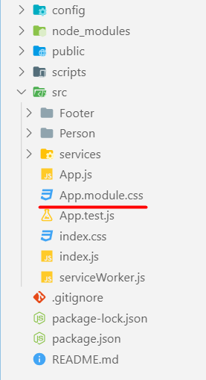
CSS Modules
React supports CSS Modules alongside regular stylesheet using the [name].module.css file naming convention
.App {
text-align: center;
}
.btn {
background-color: green;
color: white;
border-radius: 15px;
margin: 2%;
padding: 0.5%;
font-size: 24px;
cursor: pointer;
}

Slide 20
CSS Modules
CSS Modules let you use the same CSS class name in different file without worrying about naming clashes
.error {
background-color: white;
color: red;
}
CSS File called Button.module.css
import React, { Component } from 'react';
import styles from './Button.module.css';
class Button extends Component {
render() {
return <button className={styles.error}>Error Button</button>;
}
}
Importing all styles
Using error class from the css file

Slide 21

Using Fetch API

Slide 22
Fetch API
The Fetch API provides an interface for accessing and manipulating requests and responses
fetch() function which provides easy way to fetch resources asynchronously
functionality like this was previously achieved using XMLHttpRequest

Slide 23
Fetch API
fetch() takes one mandatory argument (the path to the resource you want to fetch)
second argument is optionally (init options - object)
returns a promise
once response is retrieved, there are several methods that defines what and how should be handled

Slide 24
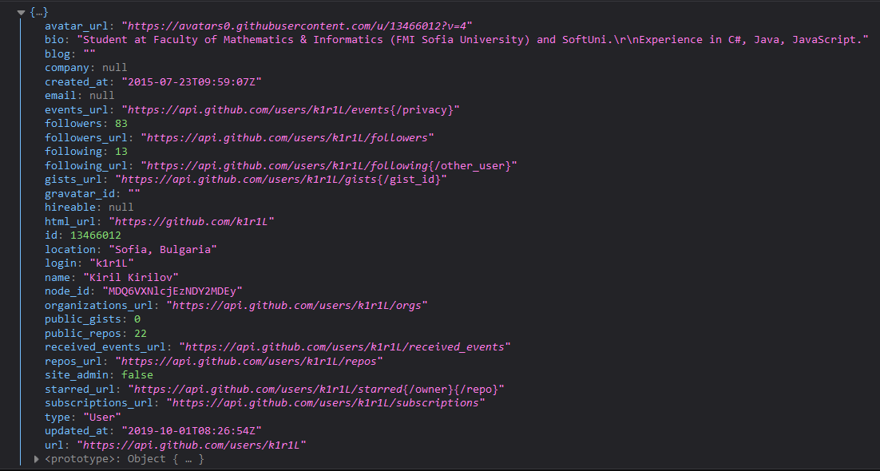
Fetch API
Fetch API with then/catch example
fetch('https://api.github.com/users/k1r1L')
.then((response) => response.json())
.then((myJson) => console.log(myJson))
.catch((myErr) => console.error(myErr));

Slide 25
Fetch API
Fetch API with async/await example
(async () => {
try {
const response = await fetch('https://api.github.com/users/k1r1L');
const myJson = await response.json();
console.log(myJson);
} catch (myErr) {
console.error(myErr);
}
})();

Slide 26
Fetch Services
The basic idea is to isolate the concern of fetching data inside components
Fetching data logic should separated as service
const apiUrl = '...';
export const getData = () => {
return fetch(apiUrl)
.then(res => res.json())
.then(data => data.results)
.catch(error => console.error(error))
};

Slide 27
Fetch Service
import { getData } from './services/fetching-data-service';
class App extends Component {
state = {
data: ...
};
componentDidMount() {
getData().then((data) => {
this.setState({ data })
});
}
render() { return ...;
}
}
Import the service
Using the service

Slide 28

Context

Slide 29
Context
Context provides way to pass data through the component tree without passing the props manually
Context API
React.createContext
Context.Provider
Class.contextType
Context.Consumer
Context.displayName

Slide 30
Context
Context is designed to share data that can be considered global
Current authenticated user
Theme
Preferred language
Using context, we can avoid passing props through intermediate elements

Slide 31
Without Using Context
class App extends React.Component {
render() {
return <Toolbar theme="dark" />;
}
}
function Toolbar(props) {
return (
<div>
<ThemedButton theme={props.theme} />
</div>
);
}
class ThemedButton extends React.Component {
render() {
return <Button theme={this.props.theme} />;
}
}

Slide 32
Using Context
const ThemeContext = React.createContext('light');
class App extends React.Component {
render() {
return (
<ThemeContext.Provider value="dark">
<Toolbar />
</ThemeContext.Provider>
);}
}
function Toolbar(props) {
return (
<div>
<ThemedButton />
</div>
);}
class ThemedButton extends React.Component {
static contextType = ThemeContext;
render() {
return <Button theme={this.context} />;
}
}

Slide 33
Context
Context is primarily used when
Some data needs to be accessible by many components at different nesting levels
Apply it sparingly because it makes component reuse more difficult
Using Context only the top-most Page Component know about your data

Slide 34
Context API
React.createContext
Creates a Context object
While rendering will read the current context value from the closest matching Provider above it in the tree
The default value is used only when a component does not have a matching Provider above it in the tree
const someContext = React.createContext(defaultValue);

Slide 35
Context API
Context.Provider
Every Context object comes with a Provider React component
Allowing consuming components to subscribe to context changes
Accepts a value prop to be passed to consuming components
One Provider can be connected to many consumers
<MyContext.Provider value={/* some value */}>

Slide 36
Context API
Class.contextType
Property that can be assigned a Context object created by React.createContext
Lets you consume the nearest current value of that Context type using this.context
You can reference this in any of the lifecycle methods including the render function

Slide 37
Context API
Context.Consumer
A React component that subscribes to context changes
Lets you subscribe to a context within a function component
Requires a function as a child
Receives the current context value
Return a React node
Value will be equal to the value prop of the closest Provider

Slide 38
Context API
Context.displayName
String property
React DevTools uses this string to determine what to display for the context
const MyContext = React.createContext(/* some value */);
MyContext.displayName = 'MyDisplayName';
<MyContext.Provider> // "MyDisplayName.Provider" in DevTools
<MyContext.Consumer> // "MyDisplayName.Consumer" in DevTools

Slide 39

Context Demo

Slide 40

Summary
Component Lifecycle
Mounting, Update and Unmounting
Higher-Order Component (HOC)
CSS Modules
Using the Fetch API
Context API provides way to pass data through the component without passing the props manually
…
…
…

Slide 41
Questions?
Notes:
41

Slide 42
Trainings @ Software University (SoftUni)
Software University – High-Quality Education, Profession and Job for Software Developers
softuni.bg
Software University Foundation
softuni.foundation
Software University @ Facebook
facebook.com/SoftwareUniversity
Software University Forums
forum.softuni.bg
Notes:
42

Slide 43

License
This course (slides, examples, demos, exercises, homework, documents, videos and other assets) is copyrighted content
Unauthorized copy, reproduction or use is illegal
© SoftUni – https://softuni.org
© Software University – https://softuni.bg
Notes:
43

